Slide 1

Group data strategy arch overview (maybe me – but could be someone else) – where does MDM fit in
What is MDM (Nishit) – very high level
Why is this a problem/why do NG need this? (Nishit/Kam)
What is the solution (Nishit) high level arch overview
What is the solution (Kam) high level people/process view
So what for the TDA – how can you help (introducing data change management into programme methods – Kam?)

Slide 2
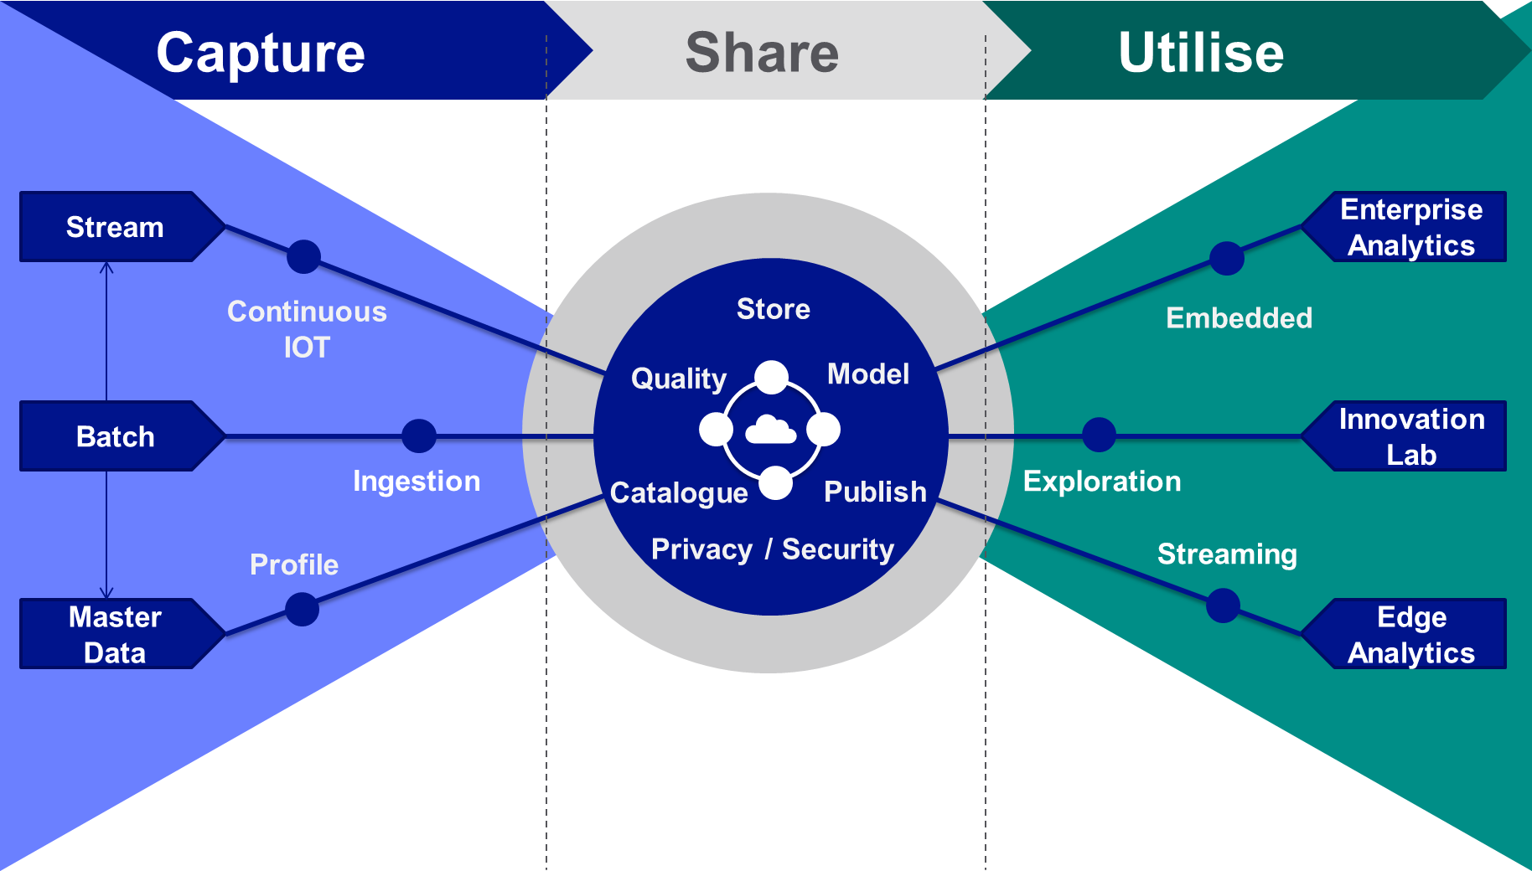

Group Data Strategy
Releasing value with data
What is the business imperative?
What are the challenges?
Data is critical for the success of the Digital Strategy:
engage our customers
improve asset health
help our employees perform
Our business units face common challenges, which we can solve collaboratively
Trust in data – Quality of data, data replication
Access to data – Siloes, tech proliferation
Value from data – Time to market
What will we do?
Value first approach (Right to Left thinking)
Capture: Manage data by mastering, cataloguing and cleansing
Share: Liberate data from source, enabling utilisation, securely
Utilise: Outcomes driven, incremental value. Innovation enabling

Slide 3
Master Data Management - Question
Data that is mastered in an application is called Master Data.
True
False

Slide 4
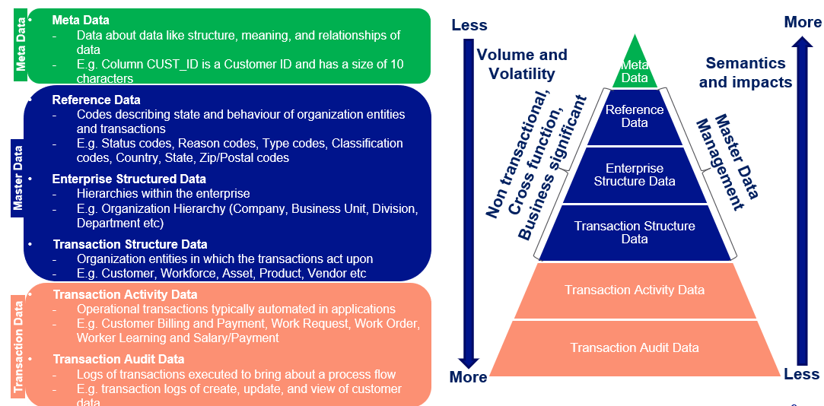
Meta Data, Master Data, Transaction Data

Slide 5
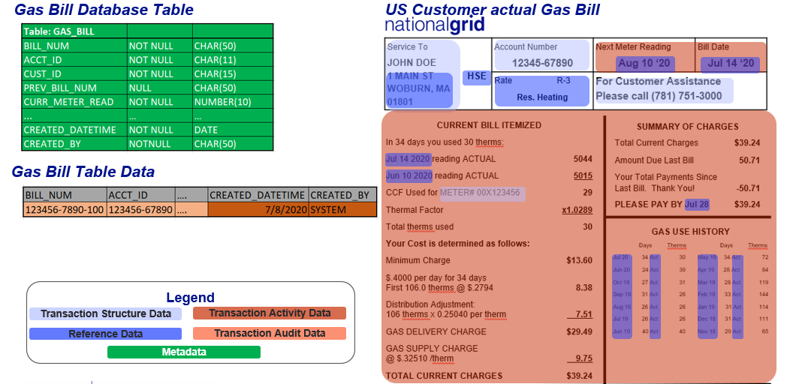
Meta Data, Master Data, Transaction Data - Examples

Slide 6
What is Master Data Management?
Master Data Management is the on-going reconciliation and maintenance of Master Data
MDM is a set of policies, standards, processes, governance, stewardships, and tools that combined create a commonly trusted, consistent, accurate, and controlled set of “master data” for critical business from across internal and external data sources and applications
MDM is used for building reliable, accurate, non-duplicative master data that National Grid business can use for effective decision making and digital transformation
Core master data entities include Customer, Workforce, Asset, Location, Product, Vendor, Reference etc.
Master Data Management
(MDM)
Governance
Policies
Processes
Tools
Ownerships
&
Stewardships
Standards

Slide 7
Master Data Management Architecture

Slide 8
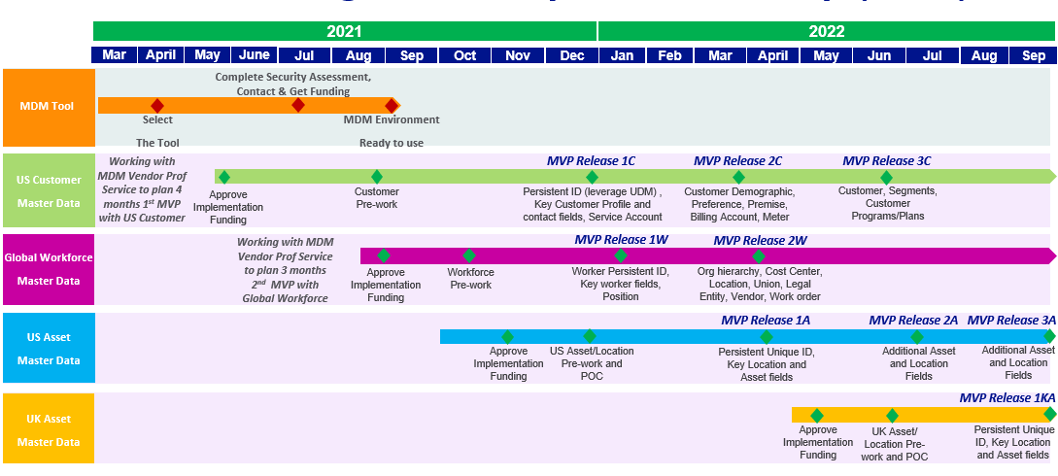
Master Data Management Draft Roadmap

